Slide 1
Considerations in the Design of Wearable Robotics for Distal Upper Extremity
Avinash Baskaran
Chad G. Rose

Slide 2
Distal Upper Extremity

Slide 3

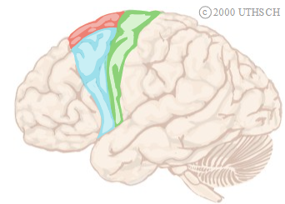
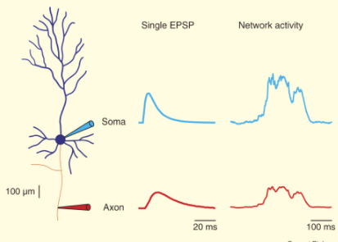
Neuromuscular patterns are governed by the central nervous system
Motor Control region of the Frontal Lobe:
Motor neuron generates potential
(thought to be a DC PWM signal)
Signal pathway:
Analog voltages transmitted through a synaptic cascade
Neuromuscular junction:
Signal delivered to muscle fibers
Nervous junction
Signal distribution
Muscle excitation
https://www.sciencedirect.com/science/article/pii/S0960982206018252

Slide 4
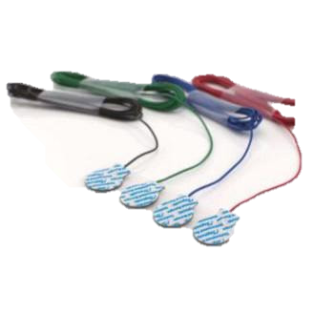
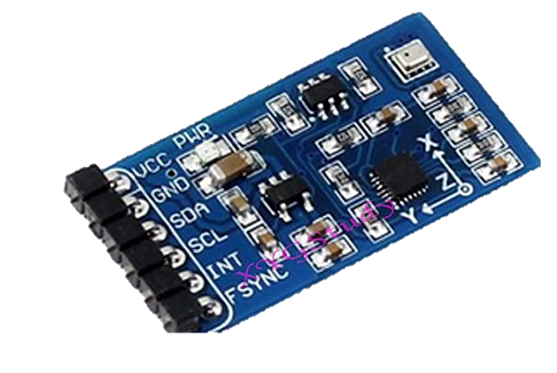
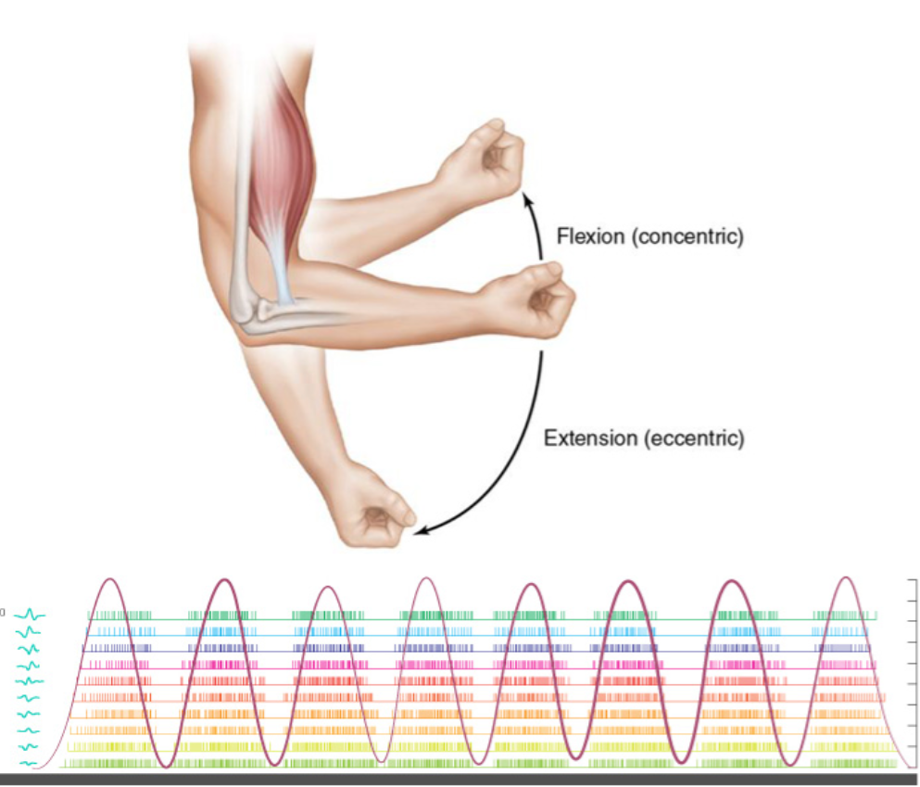
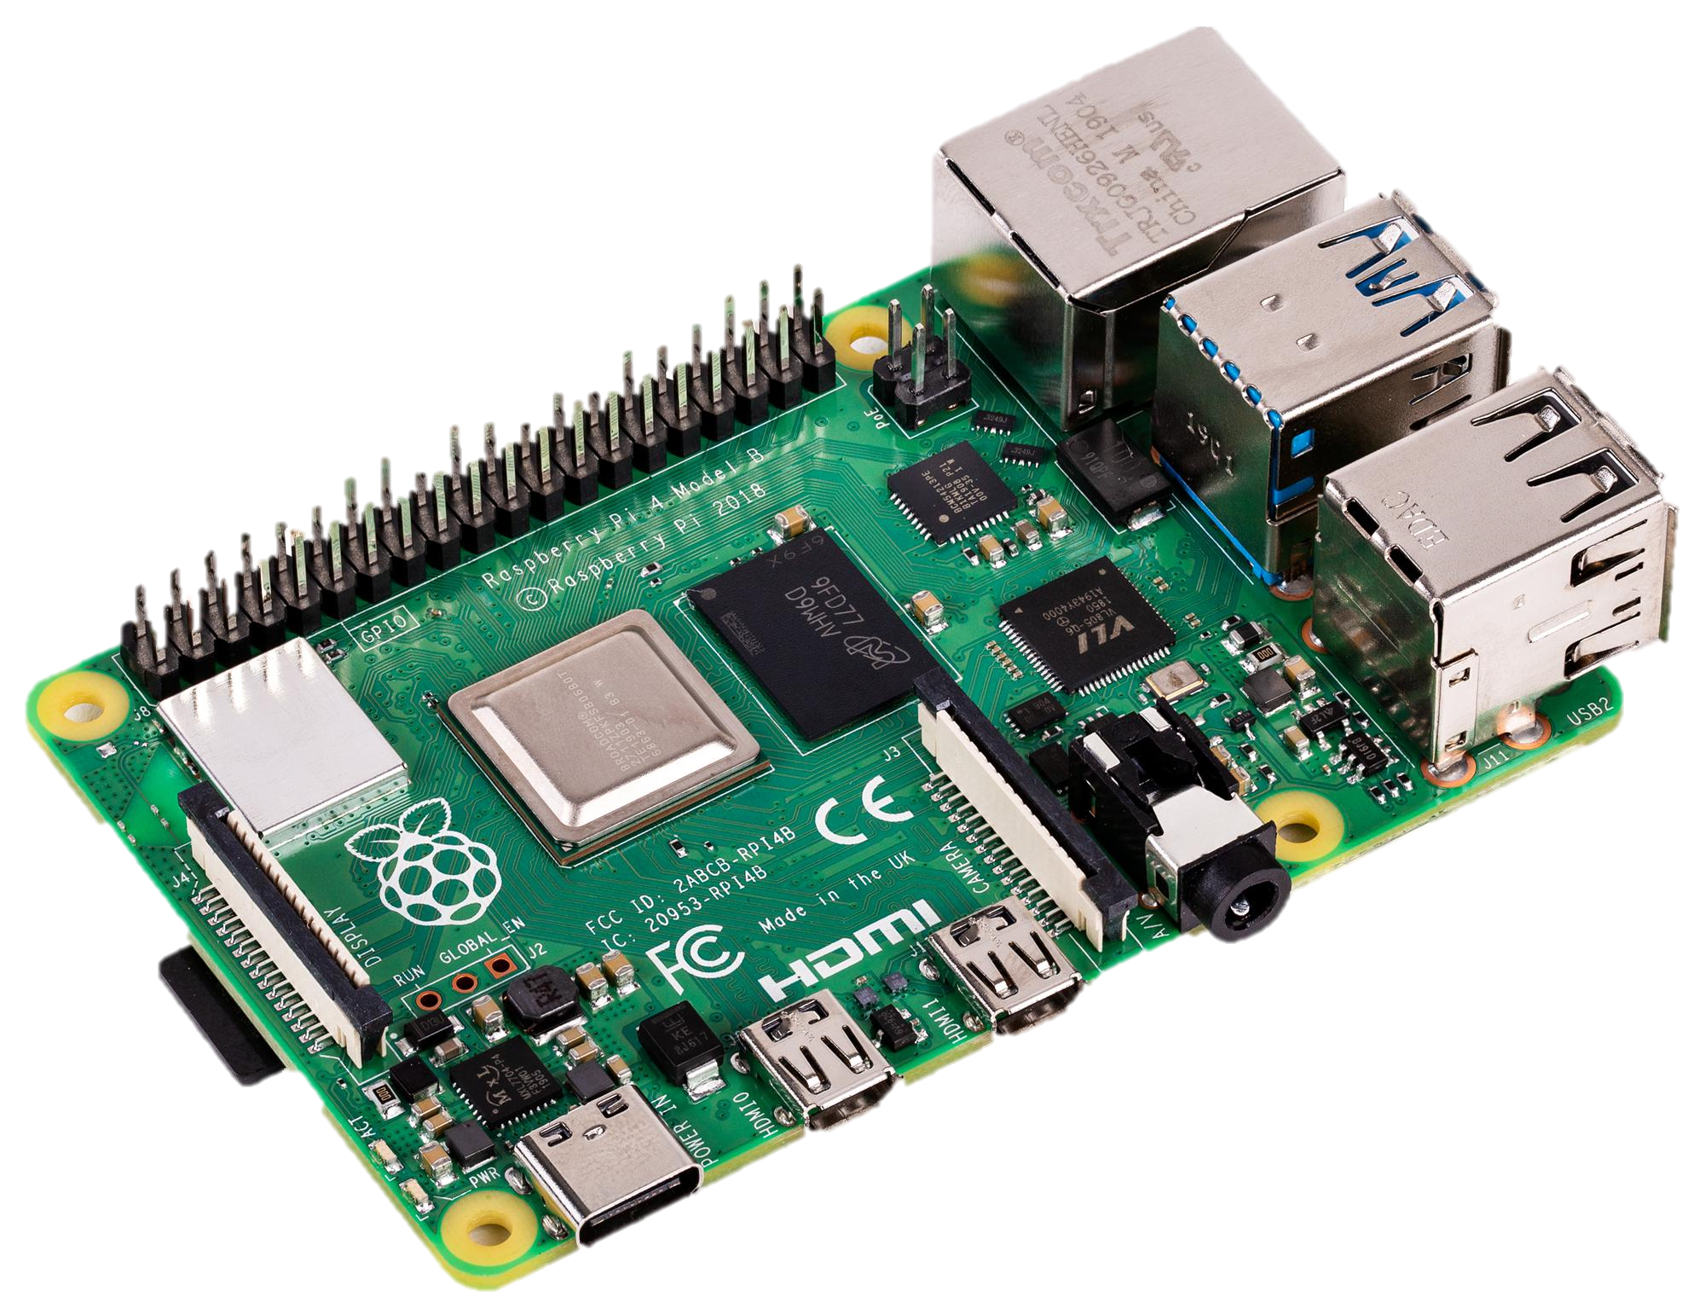
Non-invasive sensors can be used to characterize neuromuscular patterns
Kinematic Sensing
Non-invasive Myographic Sensing
Signal Analysis and processing
Recognition of
Muscle Activation and Recruitment

Slide 5
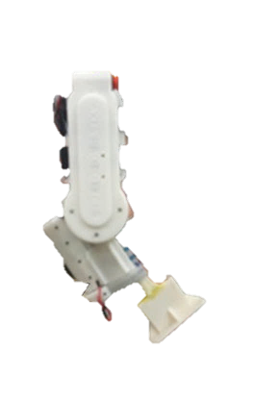
Neuromuscular patterns can inform human-robot interaction
Kinematic Sensing
Non-invasive Myographic Sensing
Signal Analysis and processing
Recognition of
Muscle Activation and Recruitment
Assistance

Slide 6
Neuromuscular pattern analysis can be used to predict and minimize fatigue
Decreased Motor Neuron Firing due to electrochemical diffusion into and from adjacent brain regions and neurons
Neuromuscular Junction:
Acetylcholine depletion due to increased muscle innervation, action potential frequency
Accumulation of peripheral fatigue Weakened Skeletal Muscle contractility due to increased lactate concentration (byproduct of ATP metabolism), decreased pH, diminished potential for electrolytic response
Accumulation of Central Fatigue Reduced capacity of central nervous system to voluntarily activate motor units
Notes:
The point: Neuromuscular Fatigue is both central and peripheral to the Neuromuscular system and is caused by the degradation of electrochemical gradients

Slide 7
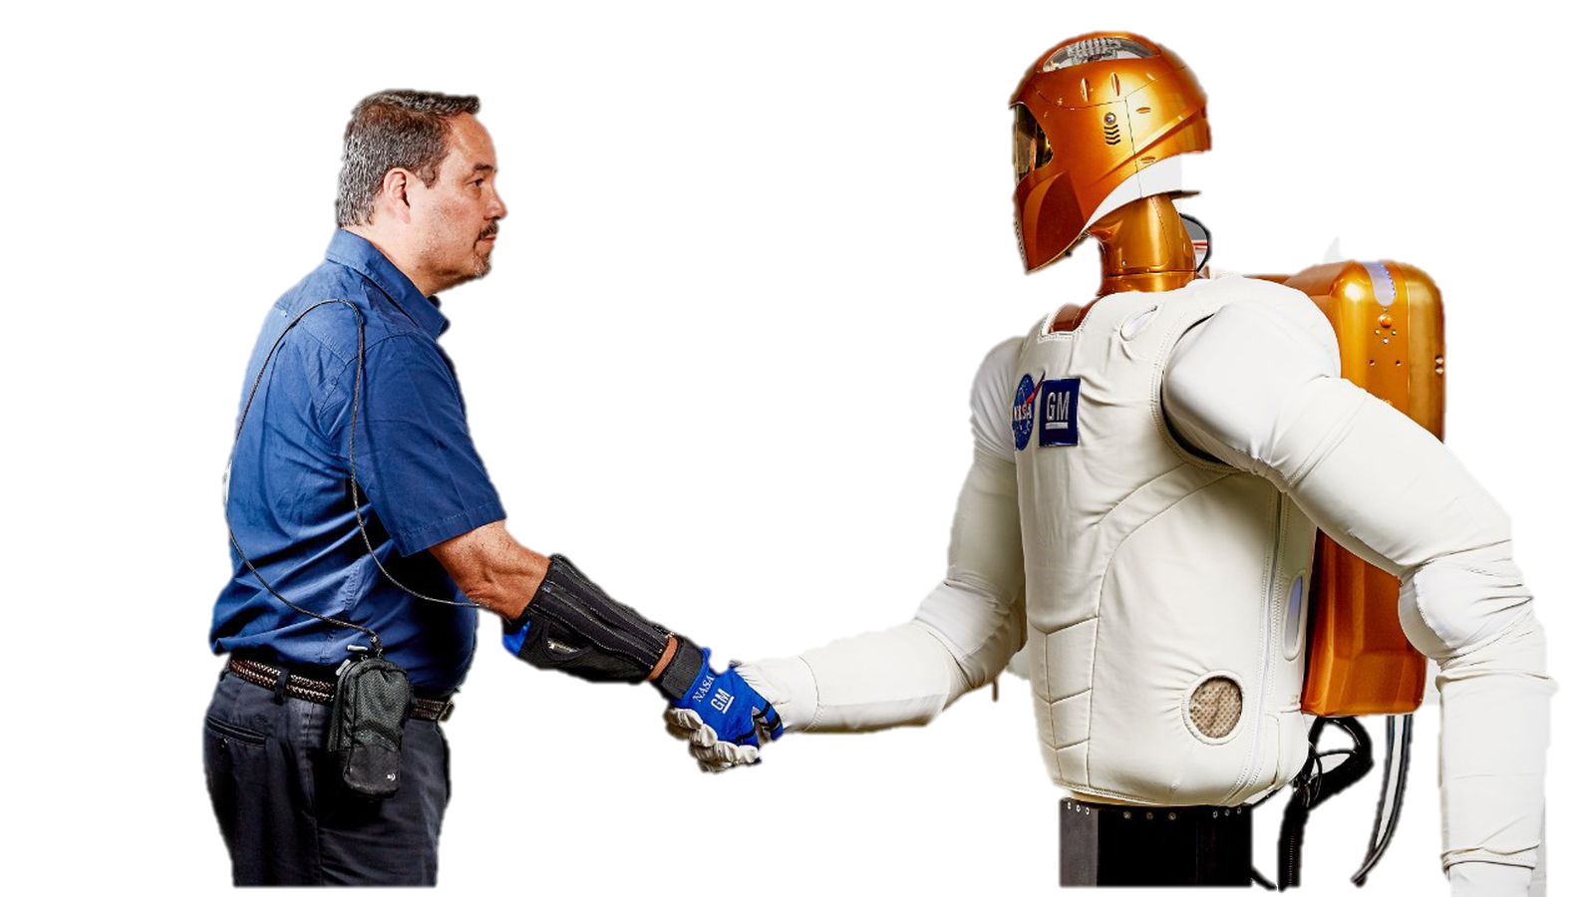

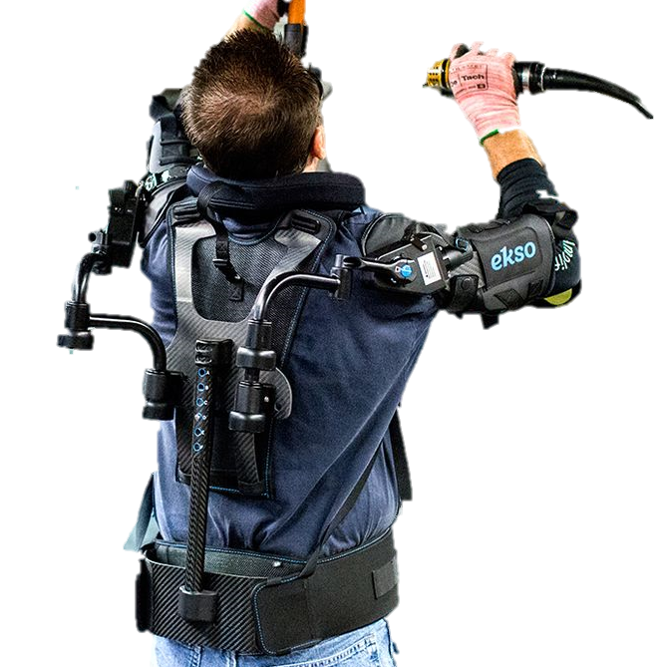
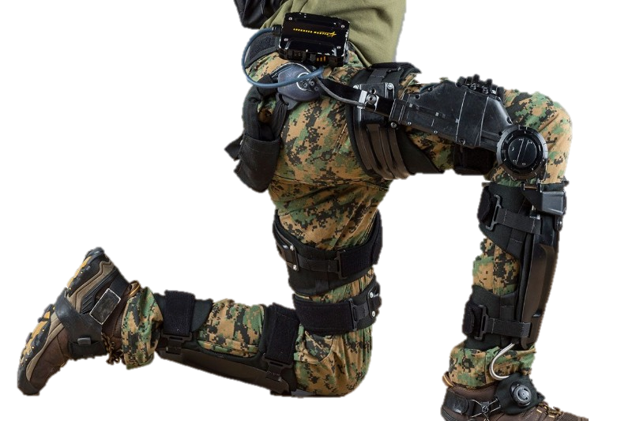
Neuromuscular fatigue analysis has a wide variety of applications
https://media.gm.com/
https://spectrum.ieee.org
https://www.army-technology.com
https://ir.eksobionics.com

Slide 8


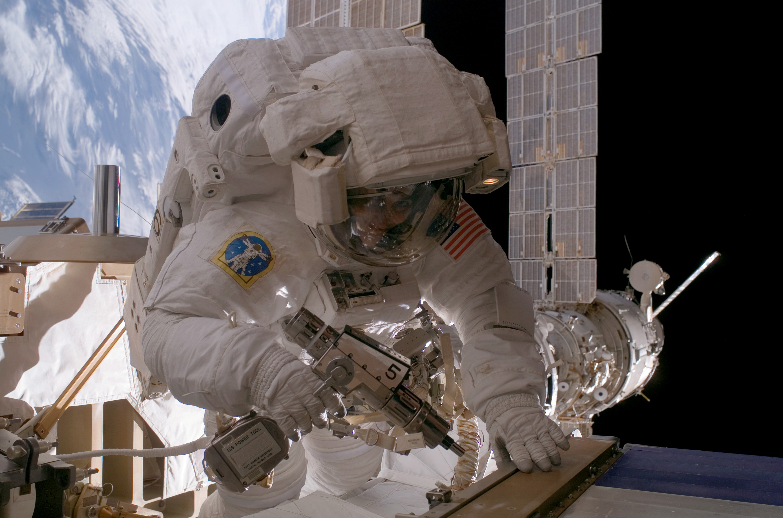


Focusing on Hand/Upper Extremity Fatigue

Slide 9
The primary contributions of this research:
Implementing a sensor-fusion spectral analysis method for Robust characterization of neuromuscular patterns
Using this method to identify fatigue and stability from neuromuscular activation data in real time
Proving that the estimates correlate well with real and perceived effects (ie. Fatigue, movement smoothness, etc.)

Slide 10
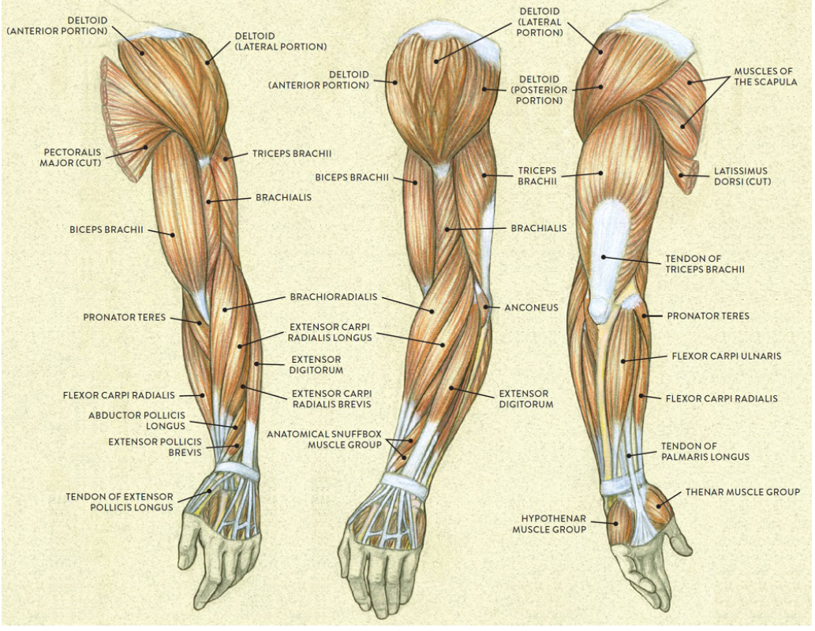
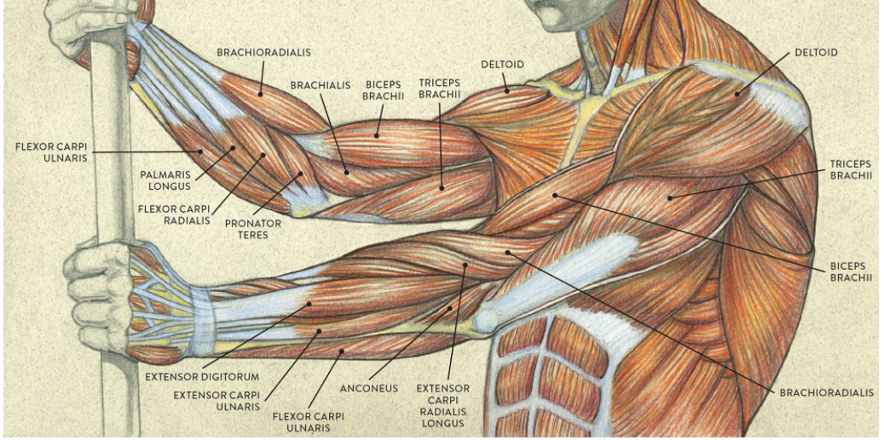
Common sEMG sensing for upper limb (1)

Slide 11
Muscles involved in voluntary movement of the arm
Shoulder:
Shoulder flexion
Anterior deltoid
Pectoralis major
Coracobrachialis
Shoulder extension
Latissimus dorsi
Teres major
Teres minor
Posterior deltoid
Shoulder abduction
Supraspinatus
Deltoid
Trapezius
Serratus anterior.
Shoulder adduction
Pectoralis major
Latissimus dorsi
Teres major
Triceps
Coracobrachialis
Medial rotation
Subscapularis
Teres major
Pectoralis major
Latissimus dorsi
Lateral rotation
Infraspinatus
Teres minor
Elbow:
Flexion (143°)
Biceps brachii
Brachioradialis
Brachialis
Extension (5°)
Triceps
Pronation (78°)
Pronator teres
Pronator quadratus
Flexor carpi radialis
Supination (85°)
Biceps Brachii
Wrist:
Flexion (73°)
Flexor carpi ulnaris
Flexor carpi radialis
Flexor digitorum superficialis
Extension (71°)
Extensor carpi radialis longus
Extensor carpi radialis brevis
Extensor carpi ulnaris
Extensor digitorum
Radial deviation (19°)
Flexor carpi radialis
Extensor carpi radialis longus
Extensor carpi radialis brevis
Ulnar deviation (33°)
Flexor carpi ulnaris
Extensor carpi ulnaris
Fingers:
Flexion
Flexor digitorum profundus
Flexor digitorum superficialis
Extension
Extensor digitorum
Extensor digitorum minimi
Abduction
Dorsal interossei
Abduction
Palmar interosseous muscles

Slide 12
Unique muscles involved in voluntary movement of the arm
13
Elbow:
Flexion (143°)
Biceps brachii
Brachioradialis
Brachialis
Extension (5°)
Triceps
Pronation (78°)
Pronator teres
Pronator quadratus
Flexor carpi radialis
Supination (85°)
Biceps Brachii
Wrist:
Flexion (73°)
Flexor carpi ulnaris
Flexor carpi radialis
Flexor digitorum superficialis
Extension (71°)
Extensor carpi radialis longus
Extensor carpi radialis brevis
Extensor carpi ulnaris
Extensor digitorum
Radial deviation (19°)
Flexor carpi radialis
Extensor carpi radialis longus
Extensor carpi radialis brevis
Ulnar deviation (33°)
Flexor carpi ulnaris
Extensor carpi ulnaris
Fingers:
Flexion
Flexor digitorum profundus
Flexor digitorum superficialis
Extension
Extensor digitorum
Extensor digitorum minimi
Abduction
Dorsal interossei
Abduction
Palmar interosseous muscles
Shoulder:
Shoulder flexion
Anterior deltoid
Pectoralis major
Coracobrachialis
Shoulder extension
Latissimus dorsi
Teres major
Teres minor
Posterior deltoid
Shoulder abduction
Supraspinatus
Deltoid
Trapezius
Serratus anterior.
Shoulder adduction
Pectoralis major
Latissimus dorsi
Teres major
Triceps
Coracobrachialis
Medial rotation
Subscapularis
Teres major
Pectoralis major
Latissimus dorsi
Lateral rotation
Infraspinatus
Teres minor
7
8
6

Slide 13
Common sEMG sensing for upper limb: Shoulder
Shoulder Flexion Extension
da Silva et. al.
Latissimus dorsi
Anterior deltoid

Slide 14
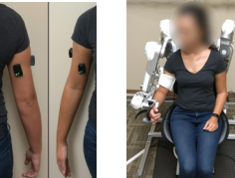
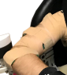
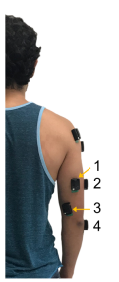
Common sEMG sensing for upper limb: Elbow
Elbow Flexion Extension
Ghonasgi et. al. Harmony Exoskeleton:
Biceps brachii
Triceps brachii
Madden et. al. monitoring fatigue (“The scope of this paper requires analysis of only the muscles that extend the elbow, that is, the triceps brachii and anconeus”)
Triceps Brachii
Long (1), lateral (2), and medial heads (3)
Anconeus Muscles (4)
Biceps Brachii
Brachioradialis
Deltoid
Anterior, Middle, and Posterior
da Silva et. al.
Biceps brachii
Triceps

Slide 15
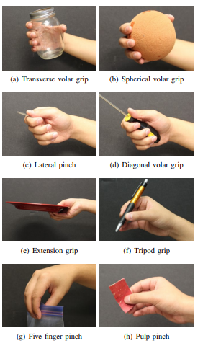
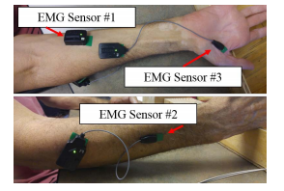
Common sEMG sensing for hand grasps
Various hand grasps / finger extension patterns
Y. Yun Maestro
“several hand grips share similar muscle activity patterns, and surface EMG sensors cannot pick up individual muscle signals…
three…distinctive hand poses… transverse volar grip, lateral pinch, and extension grip”
Flexor Digitorum Superficialis
Extensor digitorum
Flexor Pollicis Brevis/Abductor Pollicis Brevis
(taken together; collocated)
Notes:
“criteria for… (placement of sEMG electrodes) include” first that the EMG sensor must be able to measure the muscle activity of a muscle group that generates the target hand poses, second that the EMG sensors must measure non-redundant EMG signals compared to other signals measured by other EMG sensors, and lastly that EMG signals must be available for SCI subjects.”

Slide 16
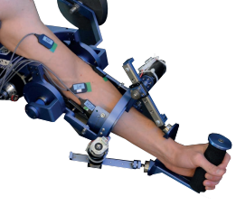
Common sEMG sensing for upper limb
Elbow Flexion/Extension, Forearm pronation/supination, Wrist flexion/extension, Wrist radial-ulnar deviation
McDonald et. al. MAHI Exo-II:
Bicep Brachii ???
Flexor Carpi radialis???
Flexor Carpi Ulnaris ???
Brachioradialis ???

Slide 17
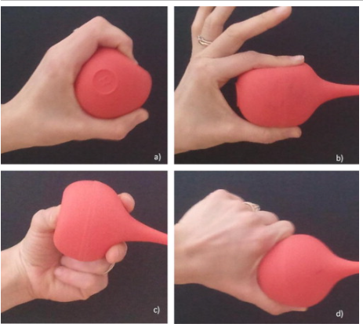
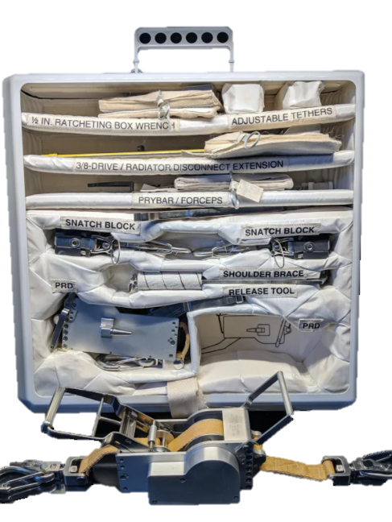
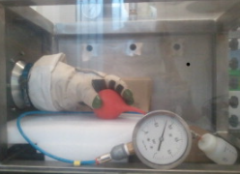
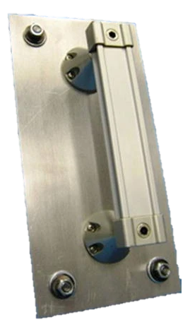
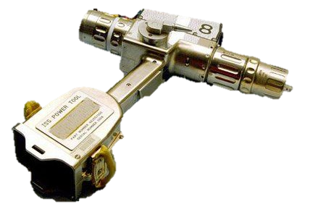
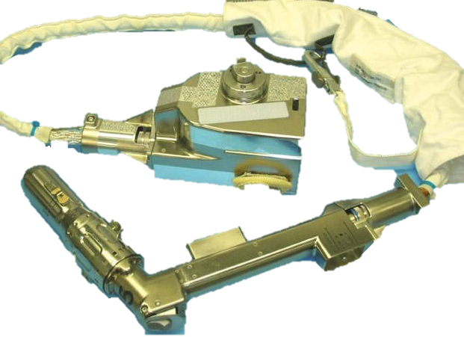
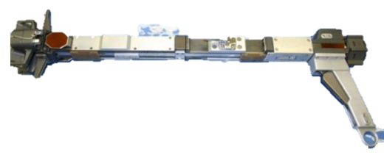
(ASGC ‘21) Space Applications
Majority of space grasps fall into a well-defined set:
Power Grasp: five fingers, with the thumb opposing)
Two-finger (precision) pinch: thumb and index finger
Three-finger (precision) pinch: thumb opposing index and middle finger
Lateral (intermediate) pinch: thumb opposing the side of the fist.

Slide 18
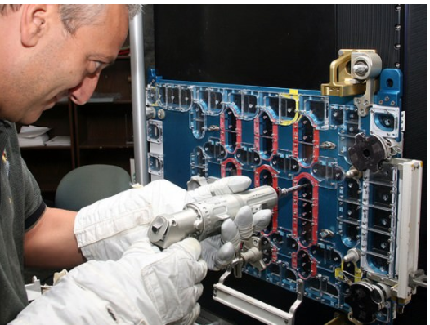
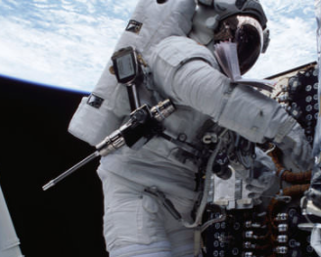
(ASGC ‘21) Space Applications

Slide 19
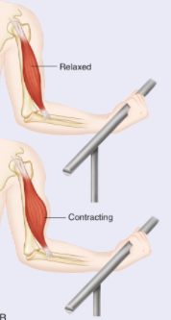
Fatigue: Frequency analysis reveals neuromuscular fatigue in isometric contractions
Isometric contraction – constant muscle length
“Amplitude and spectral parameters of the sEMG signal are closely related to the biochemical correlates of muscle fatigue.” [d]
“Decreasing trends in the sEMG median frequency [7], a spectral indicator estimated from the power spectral density of the signal, is a classical measure for quantifying and observing muscle-level fatigue” [d]
However such methods not “effective in identifying fatigue during dynamic force contractions” [d]
Notes:
sEMG readings of Isometric (ie. Constant force) muscle contraction can be considered wide-sense stationary (WSS) random process (ie. Statistically time invariant cumulative distribution)[d]

Slide 20
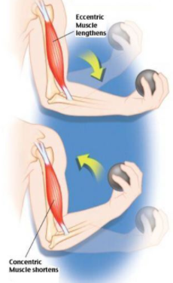
Fatigue: Dynamic contraction EMG profile more complex
Dynamic (isotonic) contraction – non-constant muscle length
Statistical non-stationarity of sEMG spectral patterns during dynamic force contractions makes fatigue analysis more difficult.
“Time-frequency distribution-based spectral estimation has shown to overcome the challenges of sEMG non-stationarity and have been proven effective in identifying fatigue during dynamic force contractions”
Notes:
sEMG readings of Isometric (ie. Constant force) muscle contraction can be considered wide-sense stationary (WSS) random process (ie. Statistically time invariant cumulative distribution)[d]

Slide 21
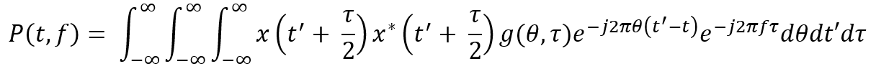
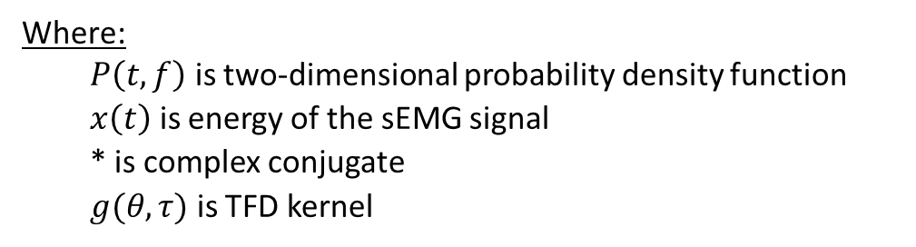
Fatigue: Estimation by Spectral Analysis
Where:
$P\left(t,f\right)$ is two-dimensional probability density function
$x\left(t\right)$ is energy of the sEMG signal
* is complex conjugate
$g(θ,τ)$ is TFD kernel
TFD Kernel:
Sliding window bounds:

Slide 22
Co-activation stability: synergistic co-activation is effected by fatigue
Muscle Synergy Theory: Some controversy but also some unanimity
“To analyze upper limb synergies, we applied non-negative matrix factorization to 14 EMG signals from muscles of 11 participants performing isometric contractions. A preliminary multidirectional task was used to identify synergy directional tuning.”

Slide 23
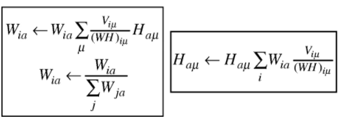
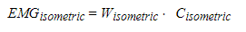
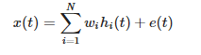
Non-negative matrix factorization (a state variable approach to modeling neuromuscular fatigue)
General form:
Iterative implementation
https://openbioinformaticsjournal.com/VOLUME/11/PAGE/53/FULLTEXT/
https://journals.plos.org/ploscompbiol/article?id=10.1371/journal.pcbi.1004737
https://www.nature.com/articles/s41598-020-65257-w

Slide 24
Bibliography
[a] https://journal.stemfellowship.org/doi/pdf/10.17975/sfj-2017-011
[b] https://pubmed.ncbi.nlm.nih.gov/15698666/
[c] https://citeseerx.ist.psu.edu/viewdoc/download?doi=10.1.1.403.1405&rep=rep1&type=pdf
[d] https://ieeexplore.ieee.org/stamp/stamp.jsp?tp=&arnumber=8396816
[e] https://pubmed.ncbi.nlm.nih.gov/29537913/
[f] file:///C:/Users/azb0180/Downloads/Fatigue_Influences_the_Recruitment_but_Not_Structu.pdf
[g] https://www.researchgate.net/publication/338586297_Estimating_the_Effect_of_Robotic_Intervention_on_Elbow_Joint_Motion/figures?lo=1
[h] https://mahilab.rice.edu/sites/default/files/page-files/2017_ICRA_Yun.pdf

